Slide 1

AHU Walkaround
Mobile application guide

Slide 2
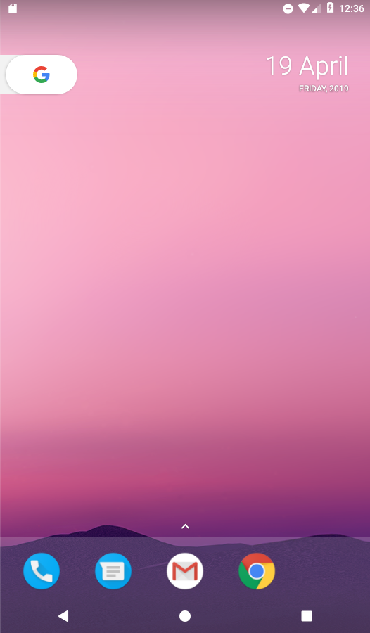
Android Basics
Home Button
  Takes you back to Home screen
View Button
  Switch between running applications
  (Warning: Closing AHU Walkaround from here will not save any unsaved data.)
Back Button
  Used to go back to previous screen
  Used to close keyboards

Slide 3
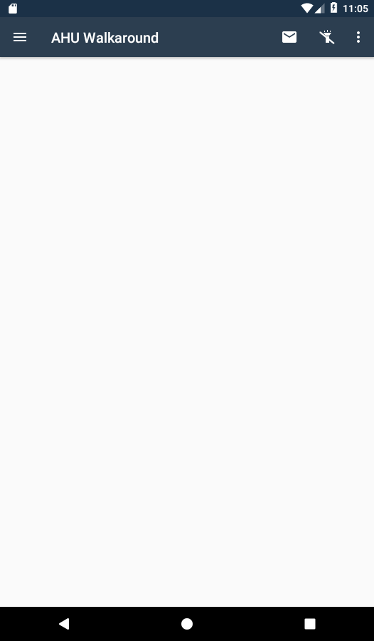
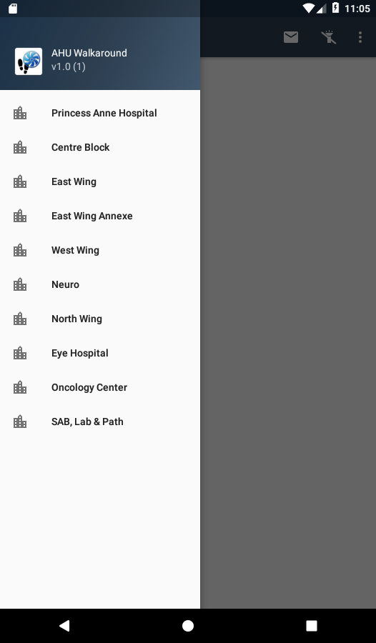
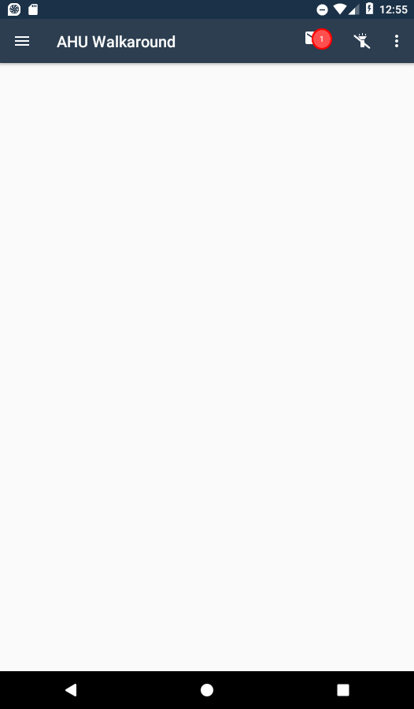
AHU Walkaround
Side drawer
  Displays a list of buildings
  Displays any incomplete walk arounds
Email Reports
  Displays a notification when reports are ready to send.
Flashlight / Torch
Application Options and settings

Slide 4
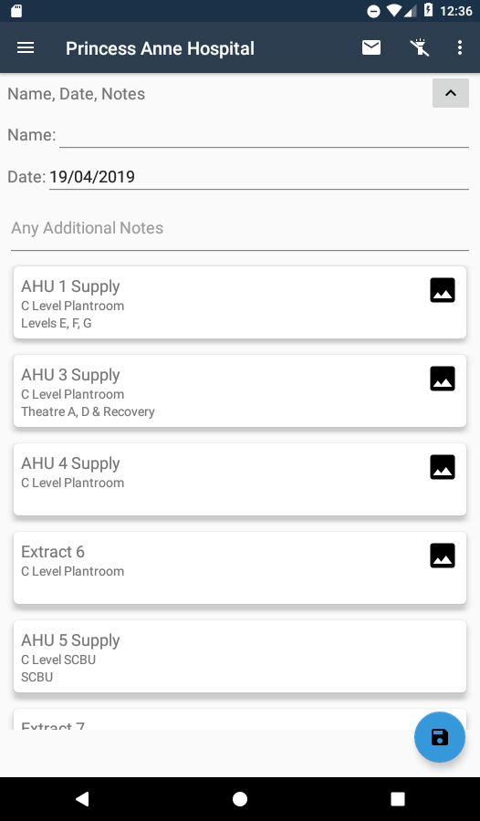
AHU Walkaround
Building Name
Inspectors Name
Inspection Date
Additional Notes
  This is the notes area for the whole report.
  Each unit also has its own individual notes section.
Toggle Button
  Can be used to hide/show area.
  Useful when long notes have been inserted.
Save Button
  It is recommended that you save your work often to avoid any loses.

Slide 5
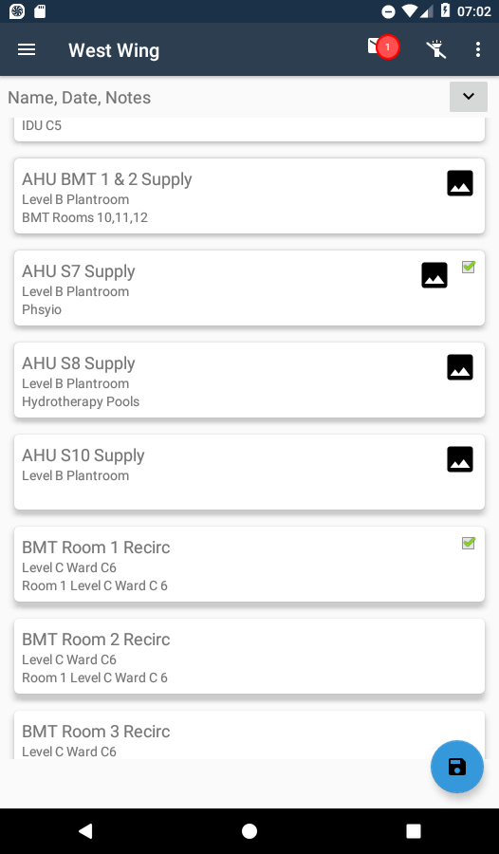
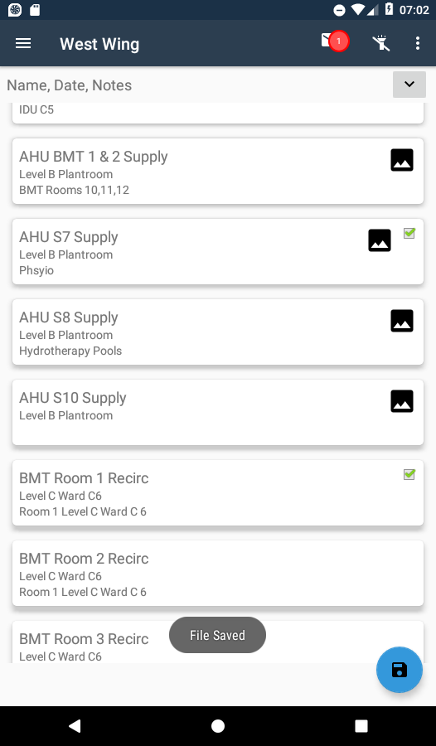
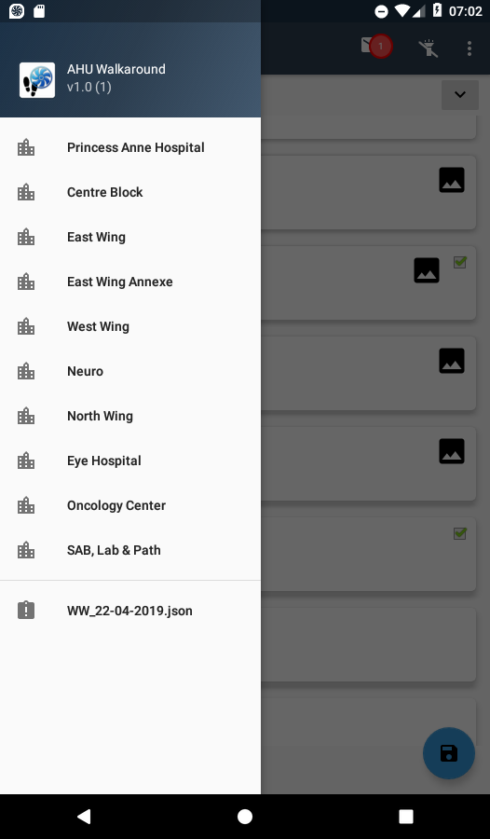
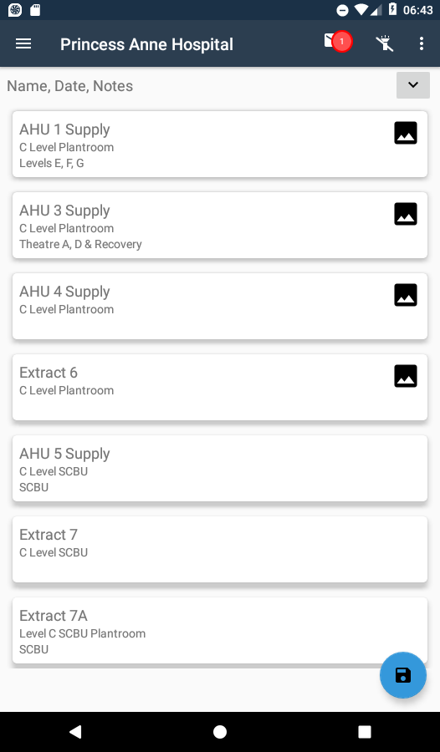
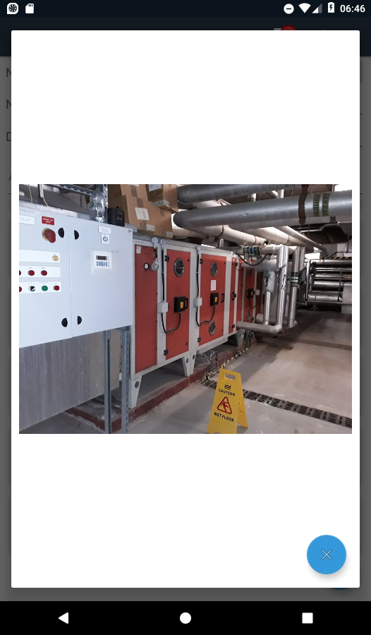
AHU Walkaround
Units with images will show the image icon
  Clicking on the icon will show the image.
Clicking the name header will expand the checklist
Completed Inspections are indicated by the checkmark.
Clicking on the save button will either
  Save or update a partially completed list
  Add partially completed list to the bottom of the drawer
  Prompt for further action.

Slide 6
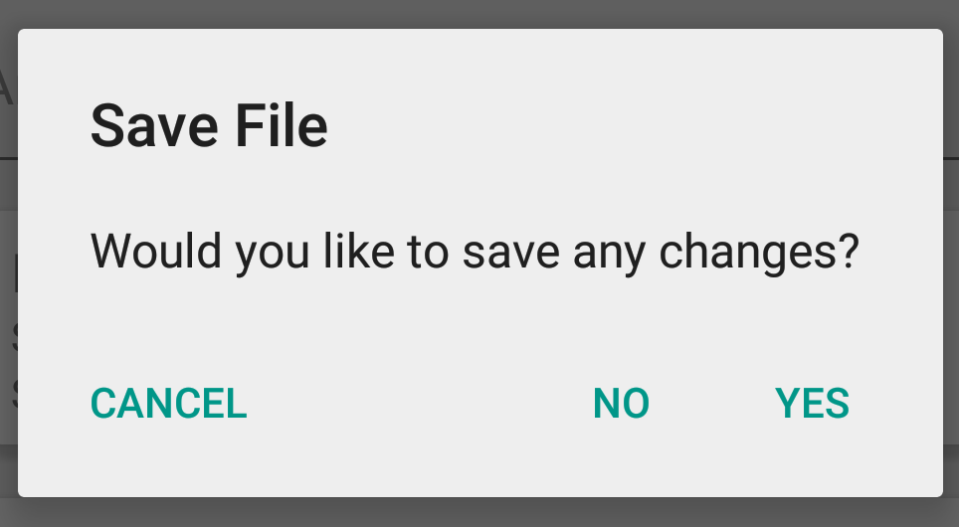
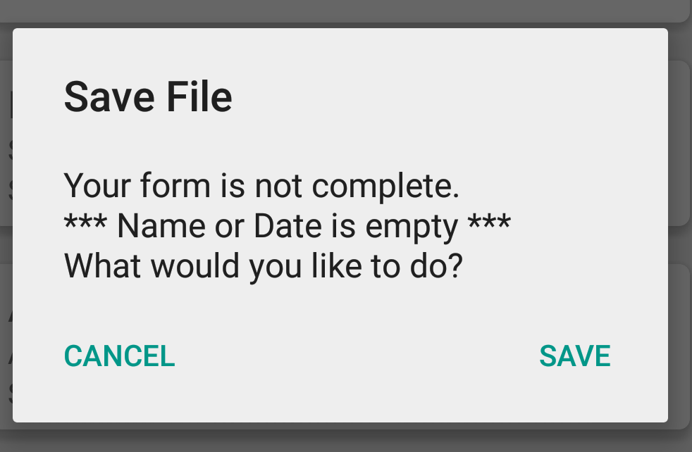
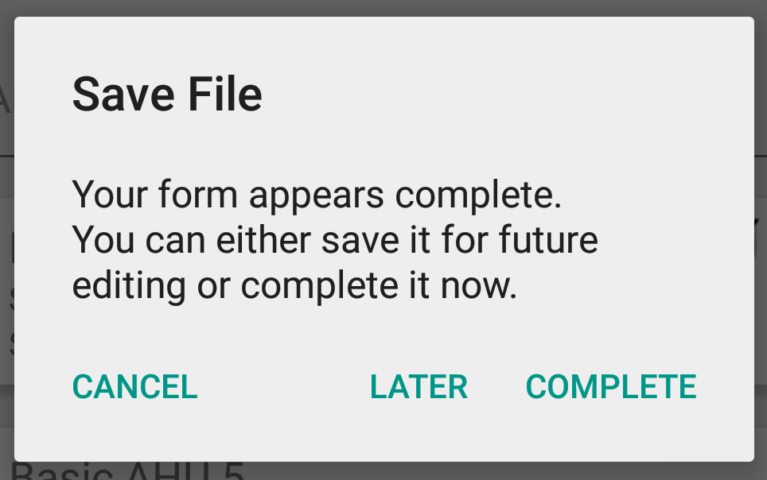
AHU Walkaround
Switching between files , buildings or saving when all checklist are complete will prompt you on how you wish to continue.
Complete
  Will take you to the signature pad to complete and sign off the list.
Later
  Will save the partial file
Cancel
  Will return you to the current list
Yes
  Will save the partial file
No
  Will discard any changes
Cancel
  Will return you to the current list
Save
  Will save the partial file
Cancel
  Will return you to the current list

Slide 7
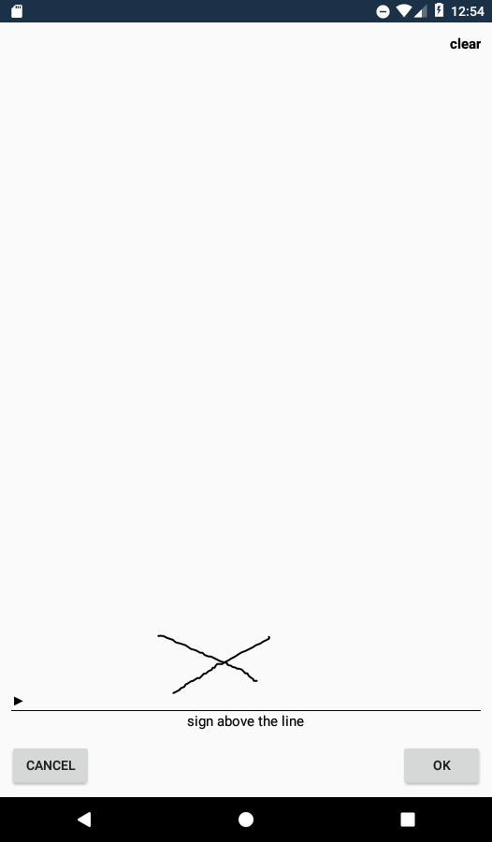
AHU Walkaround
Signing your completed list will
  Make the list ready to be made into a report
  Remove the partial file from the drawer
  Not allow you to make any other changes
If you are not happy with your signature, you can use the clear button in the top right corner, which will allow you to re-sign.

Slide 8
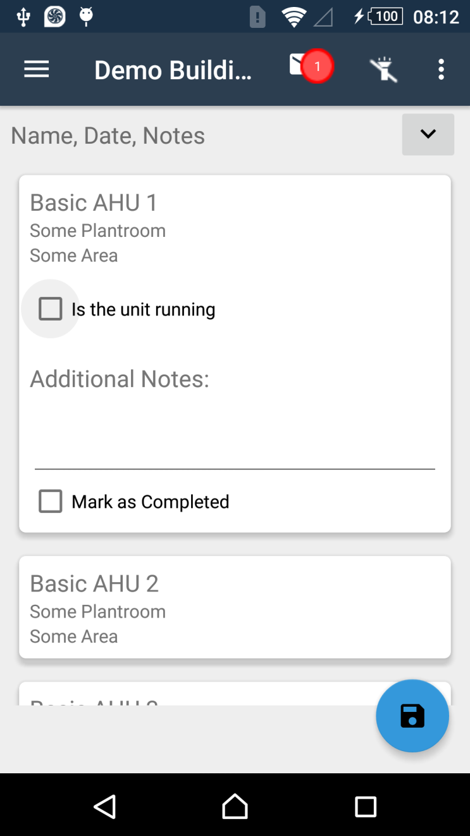
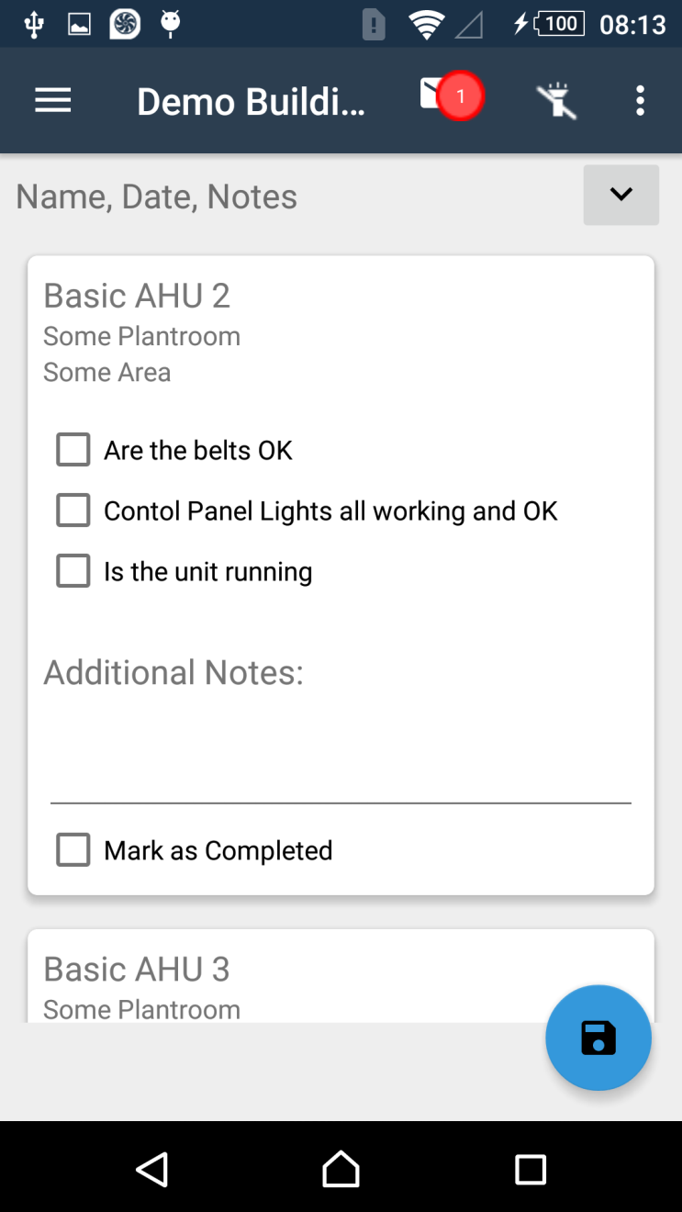
AHU Walkaround

Slide 9
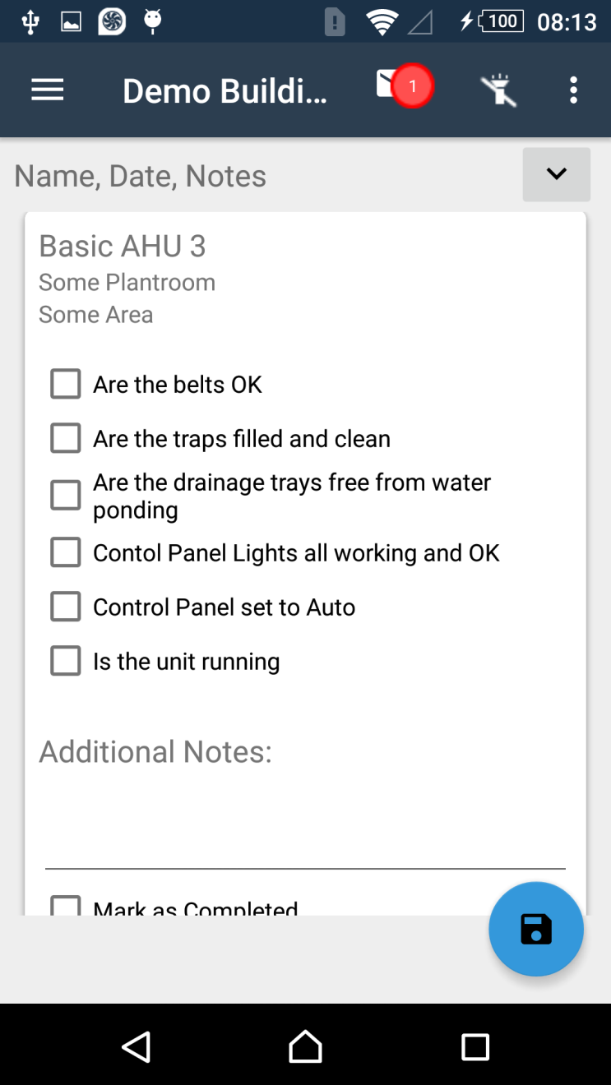
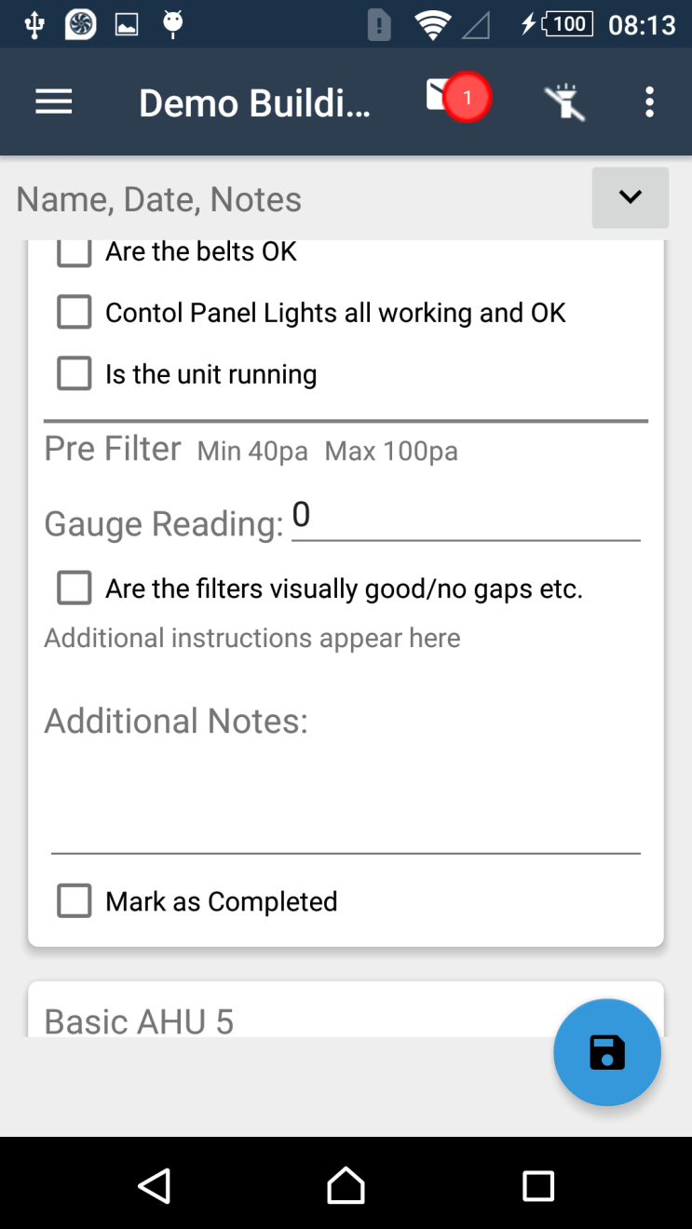
AHU Walkaround

Slide 10
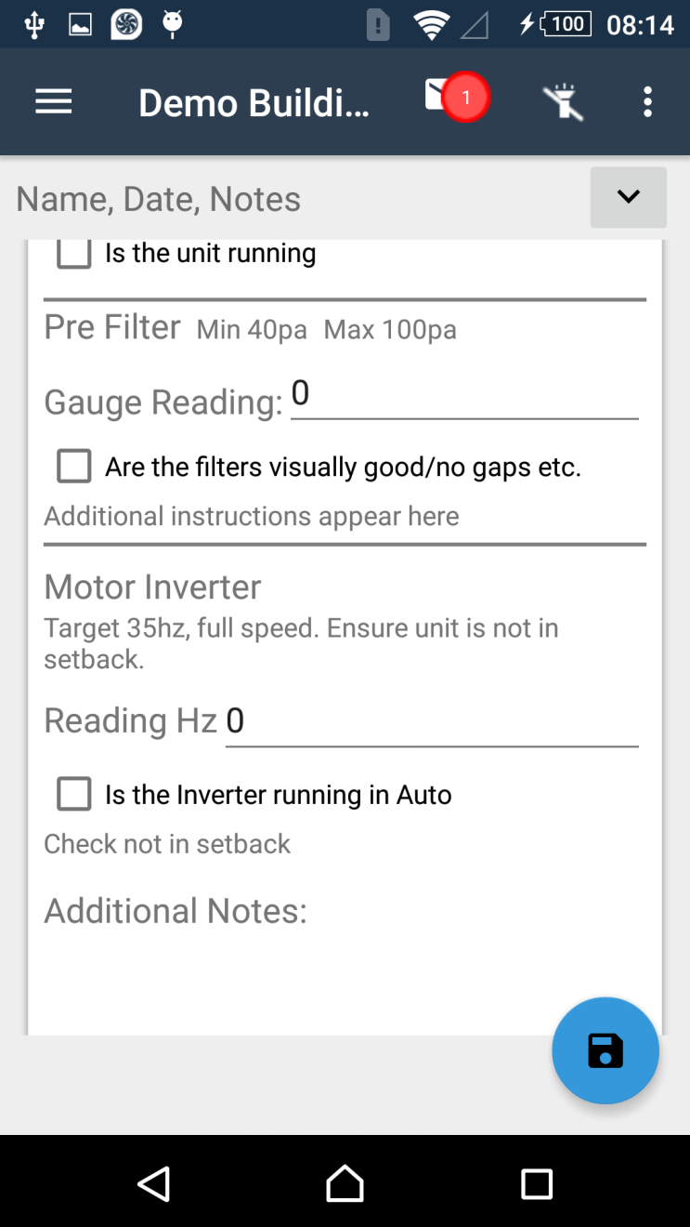
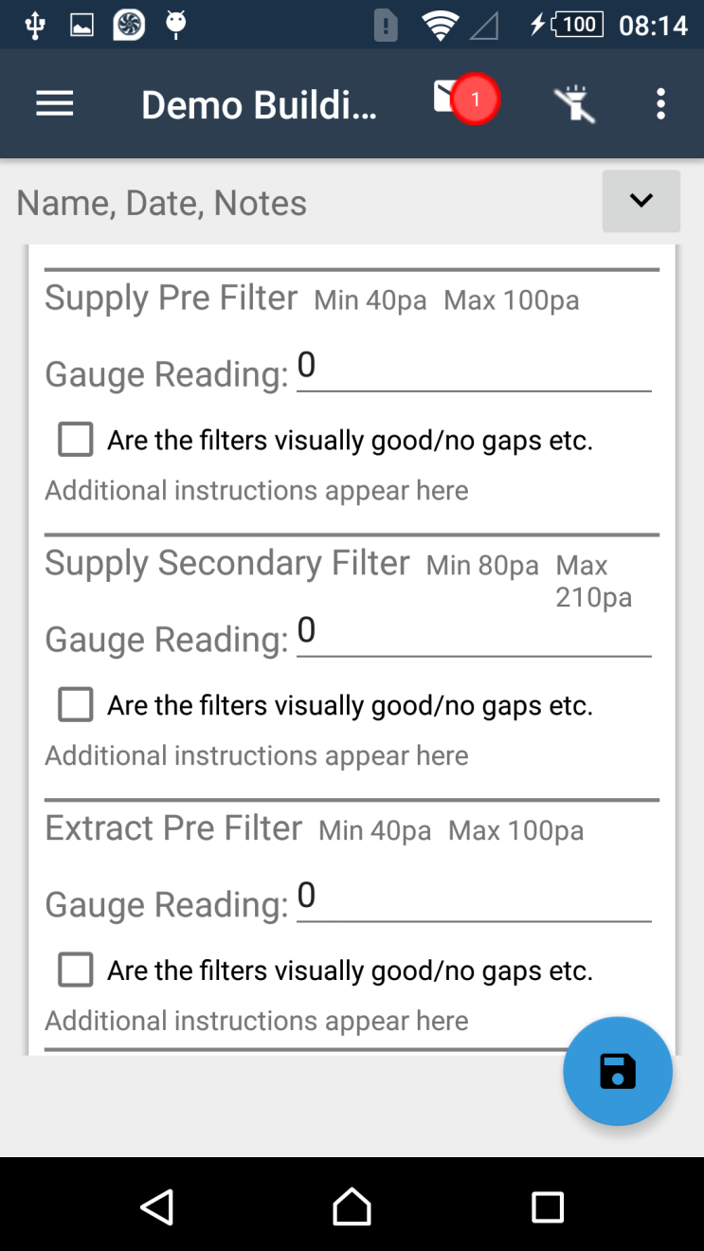
AHU Walkaround

Slide 11
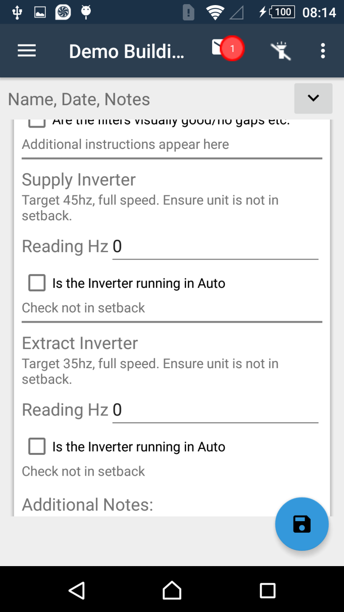
AHU Walkaround

Slide 12
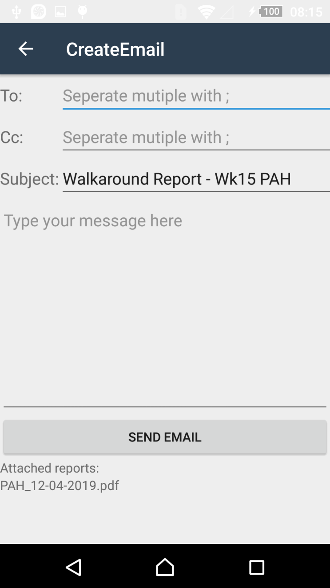
AHU Walkaround
Once you have one or more reports ready to send you can click on the email button to send the report/s.
Depending on the application settings the email addresses may be automatically entered.
Add additional addresses, separating each address with a ;
WARNING: On clicking SEND EMAIL.
Emails are sent via the default email provider on the device.
Failure to complete the process by not completing any prompts from the provider will result in not being able to send the reports from this program again.
Reports are still held on the device in the documents folder, but will require manual sending.

Slide 13
AHU Walkaround
Any Questions?

